Slide 1
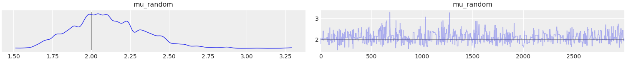
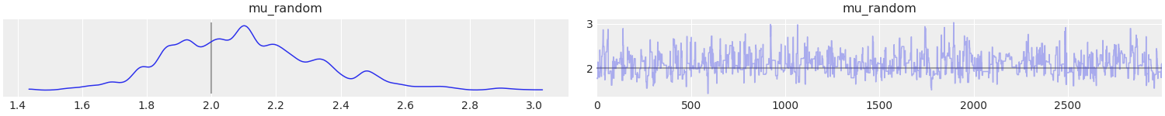
Metropolis
MLDA without VR
A1_Metropolis_MLDA.png

Slide 2
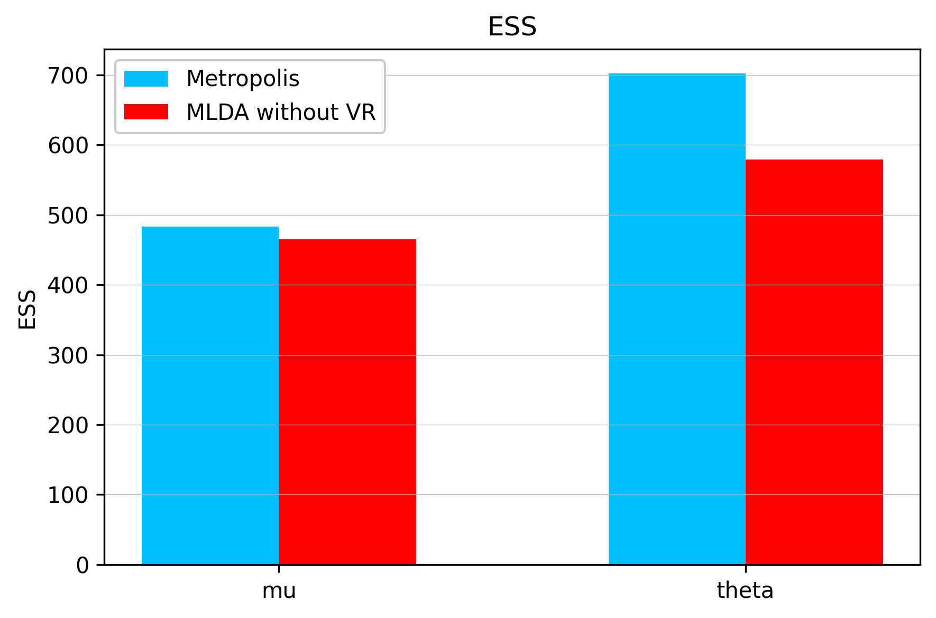
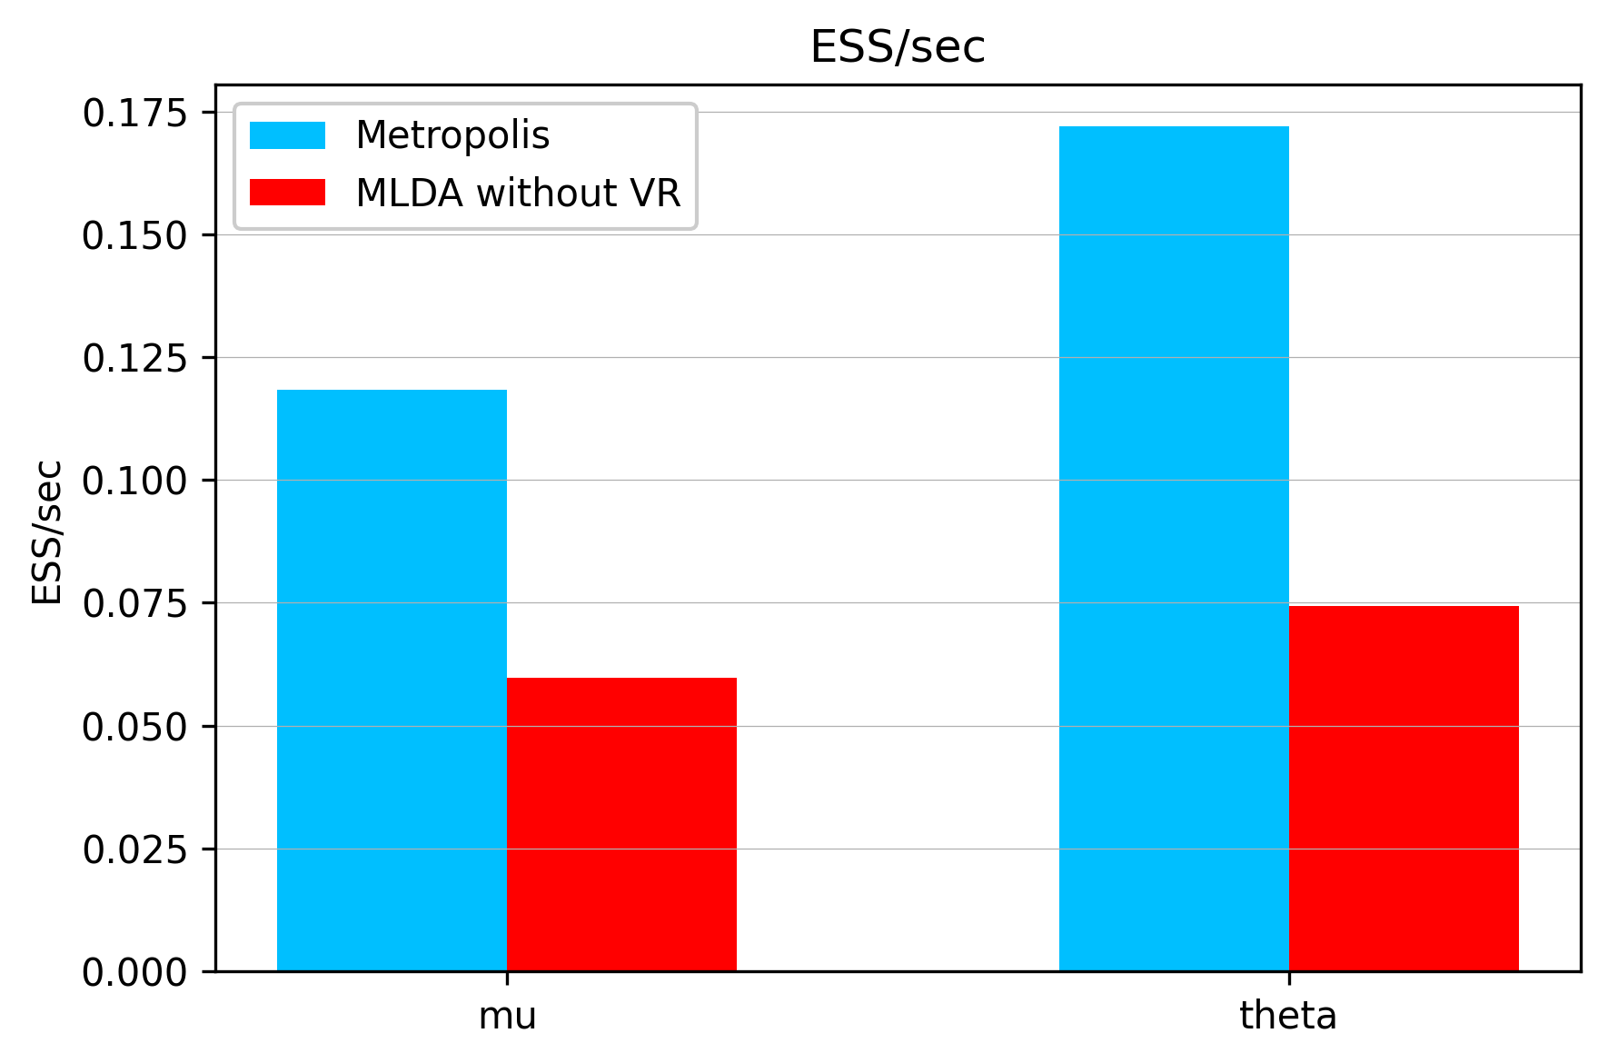
A1_ESS_Comparison.png

Slide 3
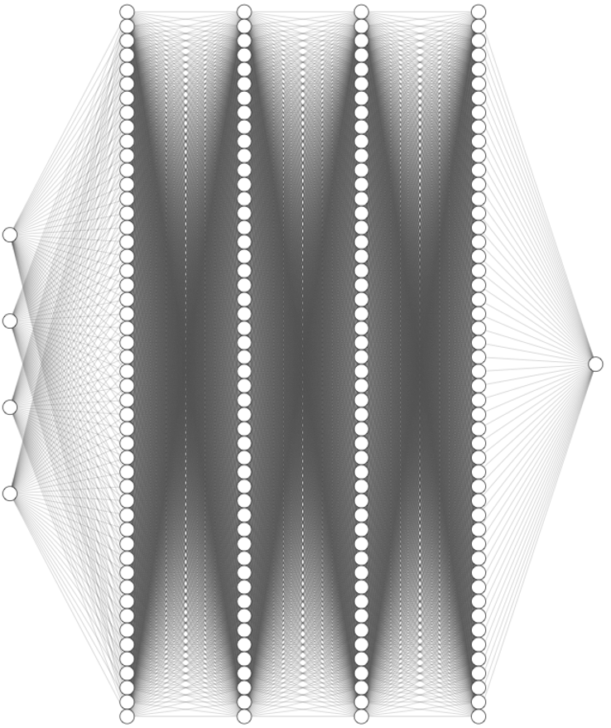
Surrogate_NN_Architecture.png
4
50
50
50
50
1
$\mu$ $\theta$ $x$ $y$ $u_{\text{NN}}(\mu,\theta,x,y)$

Slide 4
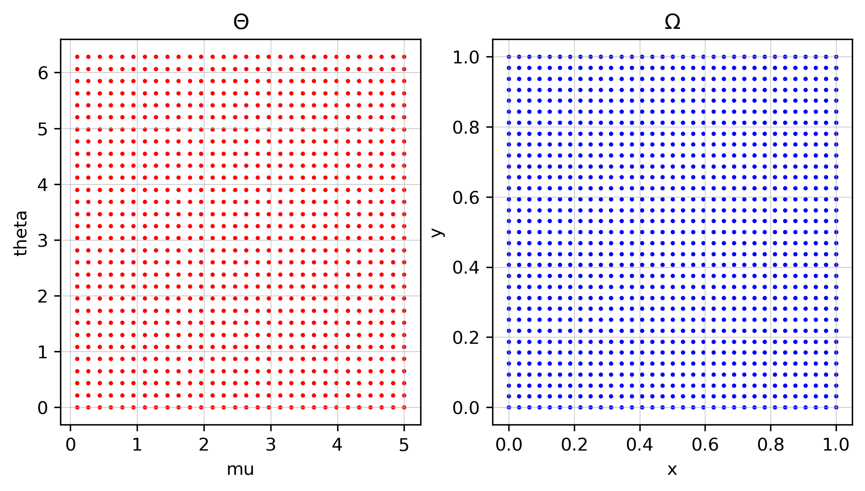
Training Data
Surrogate_Training_Data.png

Slide 5
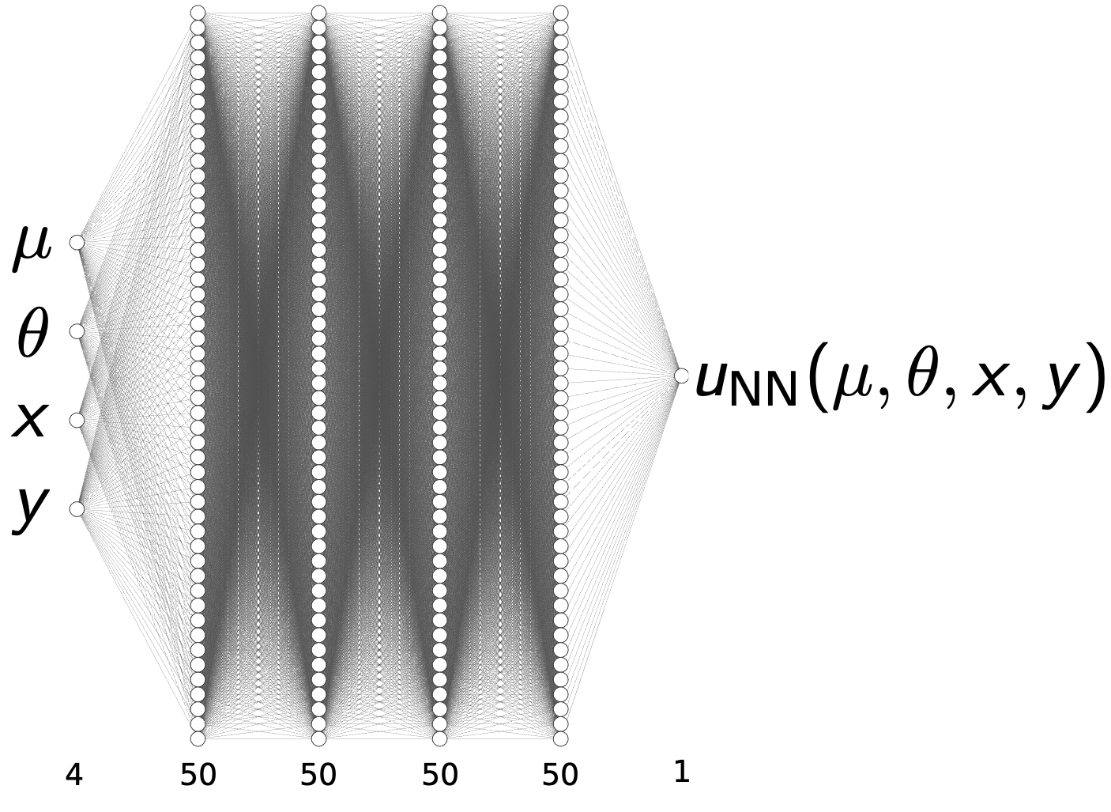
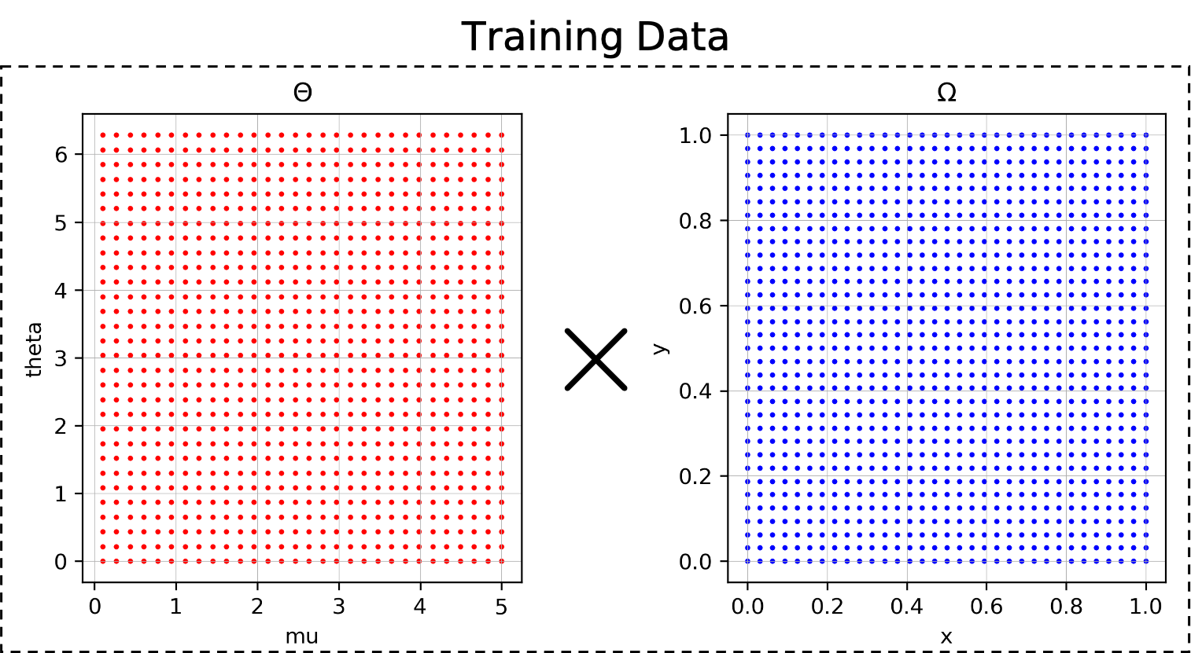
Surrogate_Images.png

Slide 6
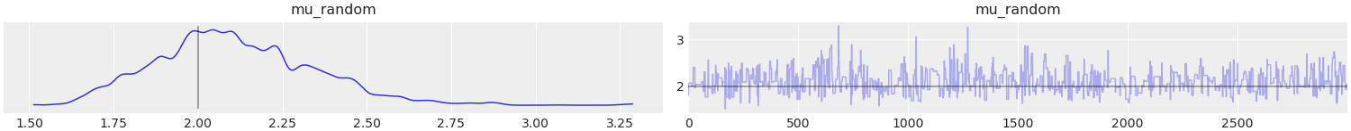
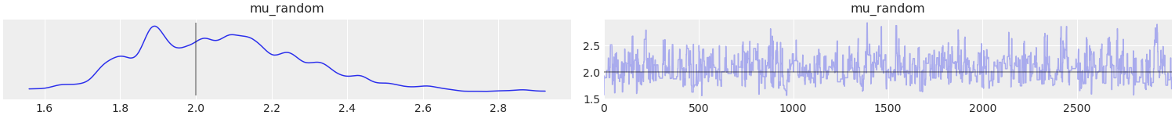
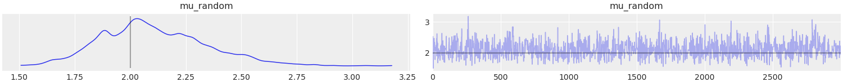
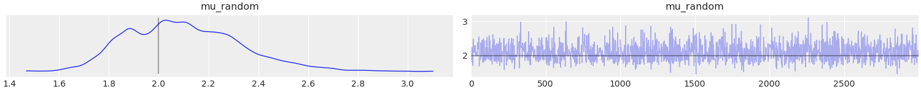
Metropolis
DEMetropolisZ
MLDA without VR (nsubs = 5)
MLDA without VR (nsubs = 20)
A2_Traceplots.png

Slide 7
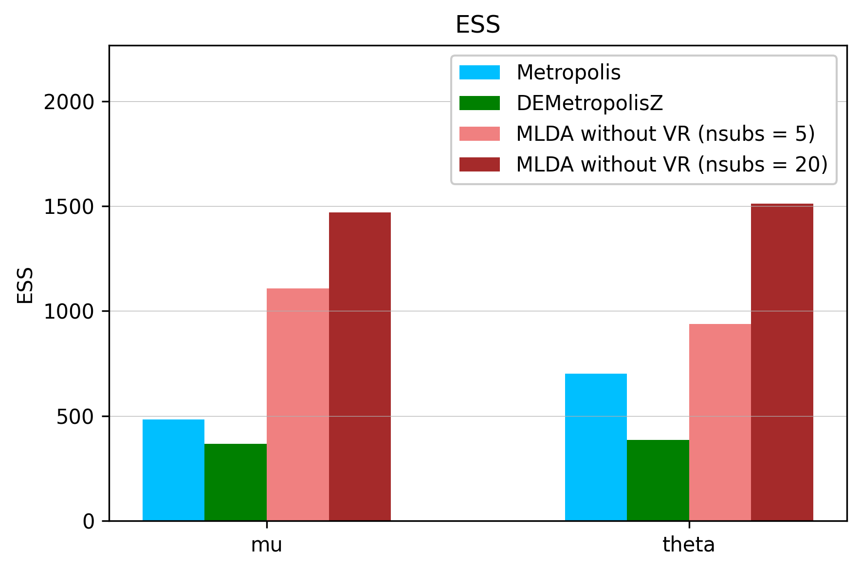
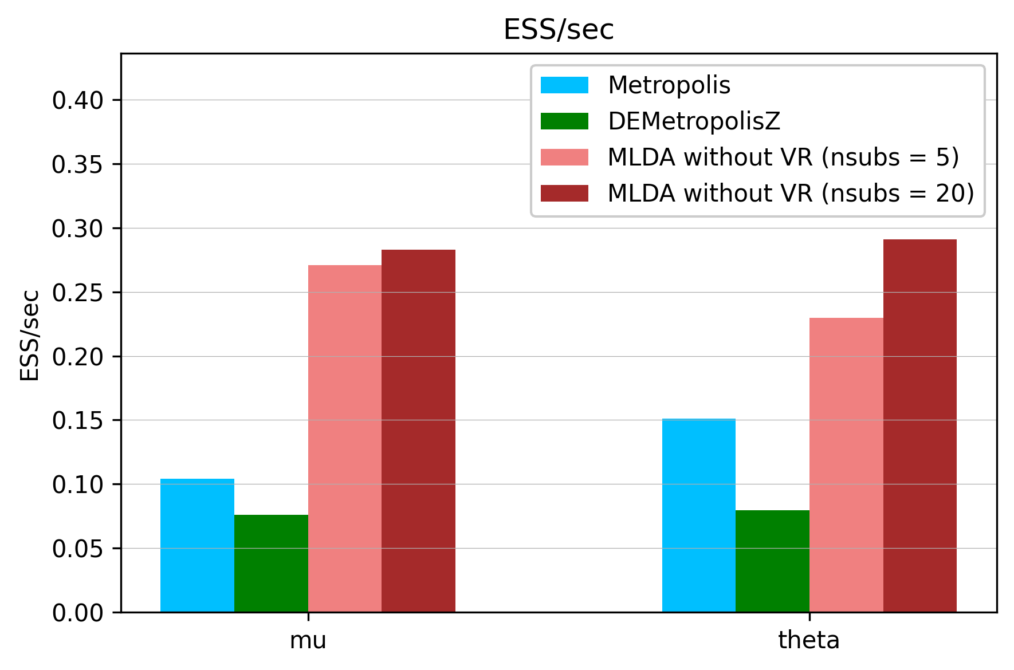
A2_ESS_Comparison.png

